Slide 1
Docker session
A Simple guide to dockerland

Slide 2
What is Docker? And Why?
Docker is a container technology: A tool for creating and managing containers.
OH, ok , what is container ?!
Container is A standardized unit of Software A package of code and dependencies to run that code (e.g. NodeJS code + the NodeJS runtime)

Slide 3
Containers behavior
The same container always yields the exact same application and execution behavior! No matter where or by whom it might be executed.
Support for Containers is built into modern operating systems!
Docker simplifies the creation and management of such

Slide 4
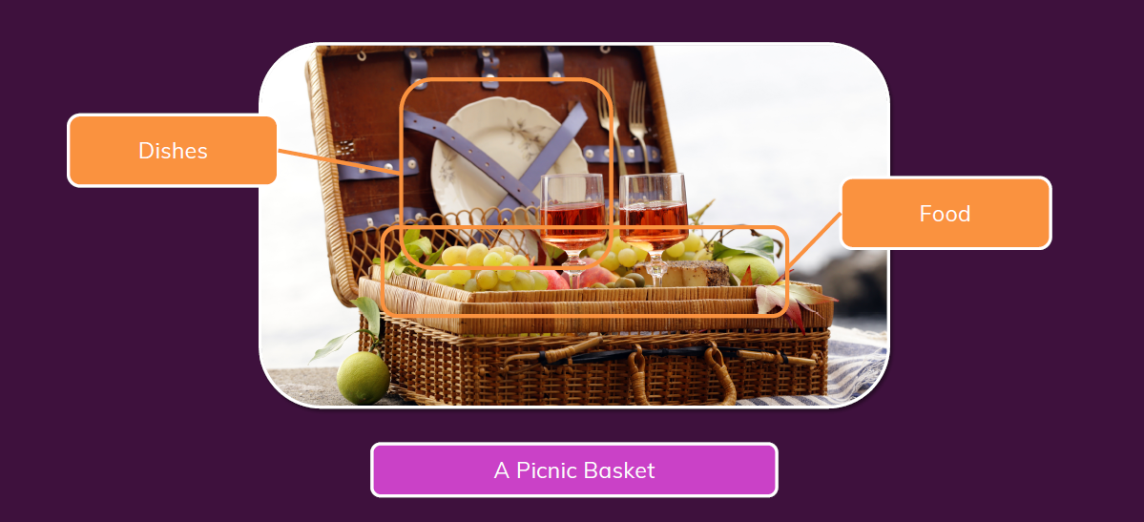
Real life example (panic basket)

Slide 5
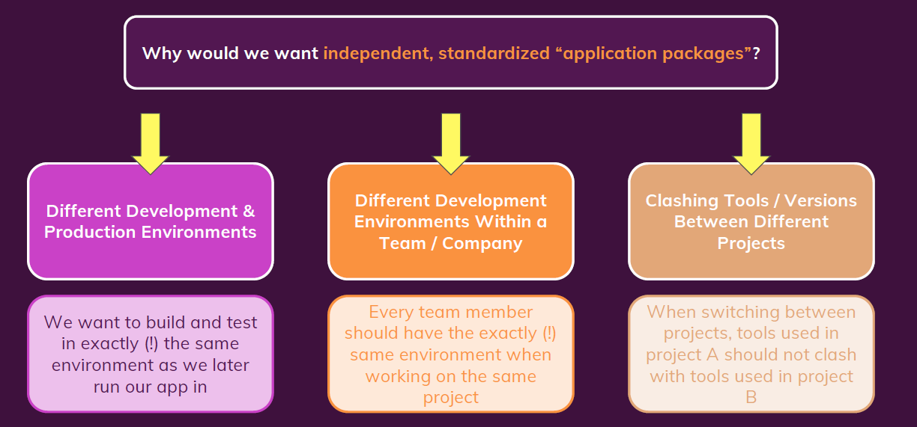
Why containers

Slide 6
Problem caused by different enviroments
Firstly what is environment ??
Environment: The runtimes, languages, frameworks you need for development.

Slide 7
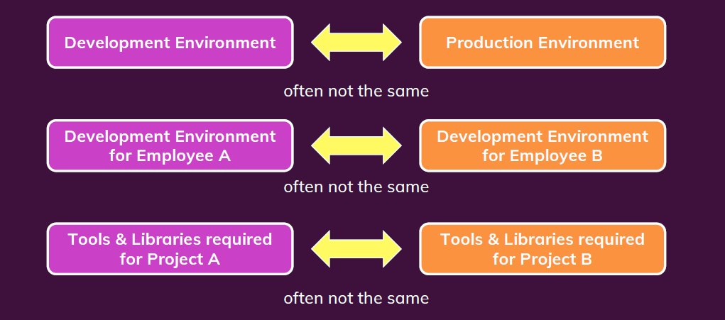
Dev vs. prod env

Slide 8
Conclusion
We want to have the exact same environment for development and production èThis ensures that it works exactly as tested.
It should be easy to share a common development environment/ setup with (new)employees and colleagues.
We don’t want to uninstall and re-install local dependencies and runtimes all the time.

Slide 9
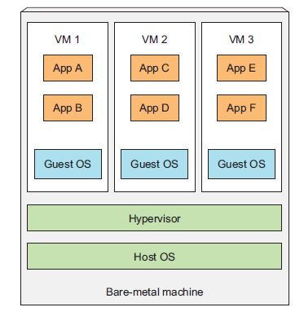
Virtual machines
When you run three VMs on a host, you have three completely
separate operating systems running on and sharing the same
bare-metal hardware.
Wastes a lot of space on your hard drive and tends to be slow.

Slide 10
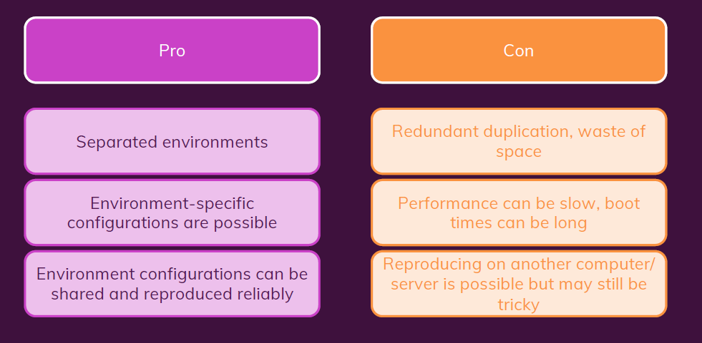
Virtual Machines / Virtual OS: Summary

Slide 11
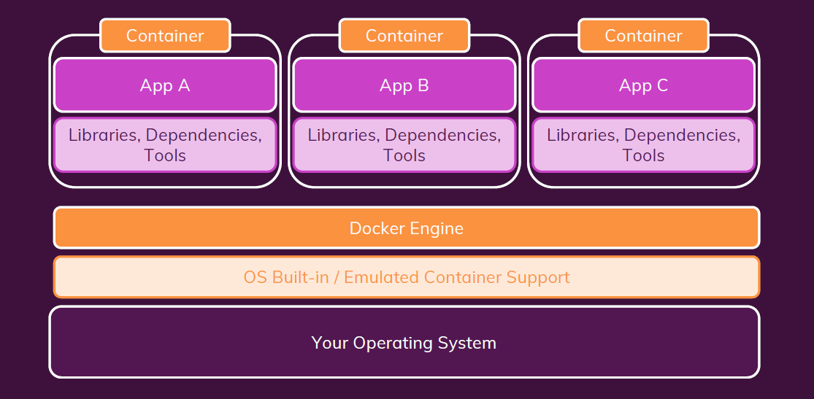
Docker system

Slide 12
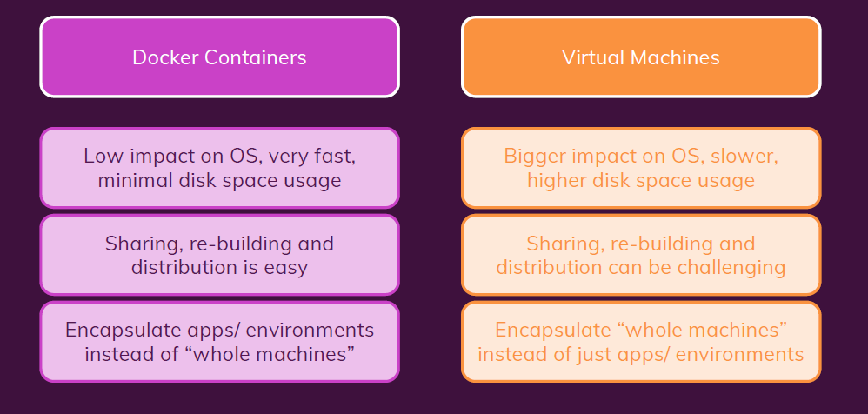
Containers vs Virtual Machines

Slide 13
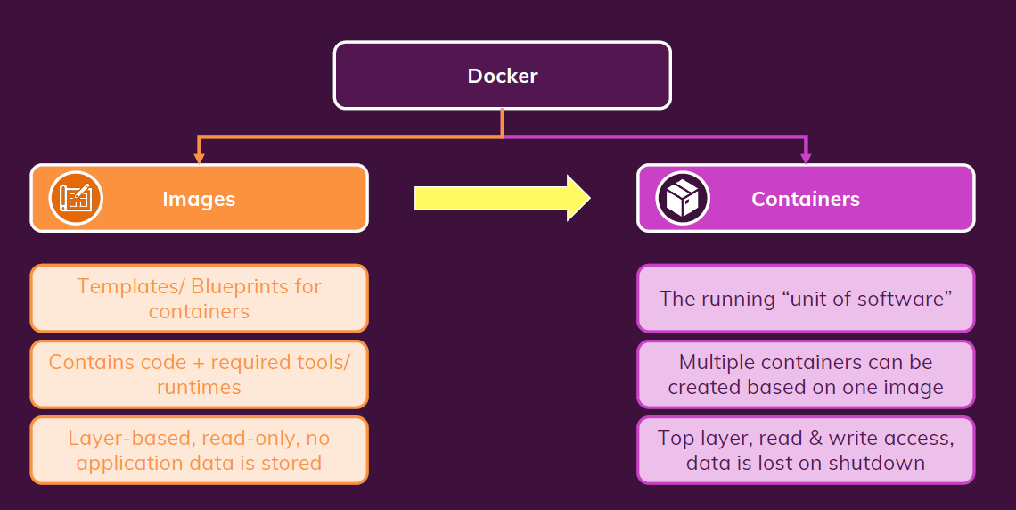
Images vs Containers

Slide 14
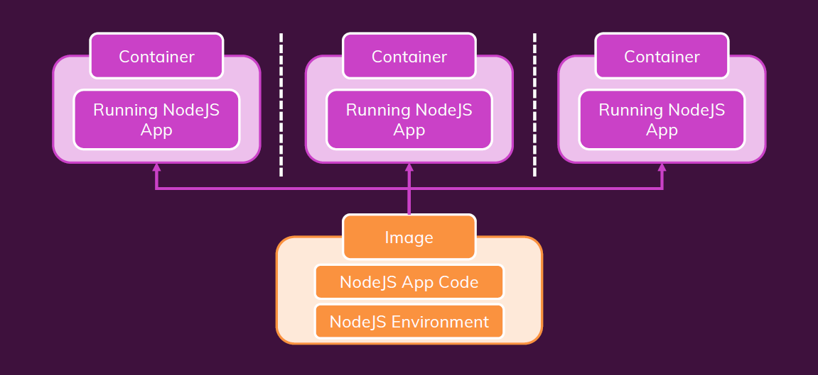
One Image, Multiple Containers

Slide 15
Finding / Creating Images
Use an existing, pre-built Image (e.g. vie Docker Hub https://hub.docker.com/)
Create your own, custom Image: Write your own Dockerfile (based on another Image). (e.g. node JS app based on node JS as base image).

Slide 16
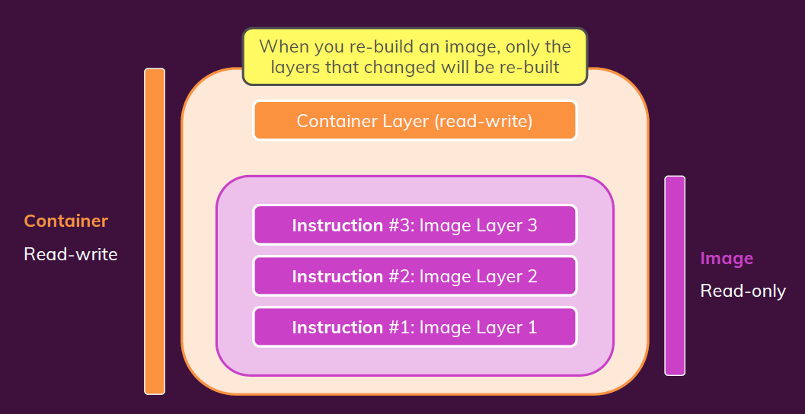
A Container Is Based On An Image
When you re-build an image, only the layers
that changed will be re-built(caching).
Multiple Containers Can Be Based On
The Same Image.

Slide 17
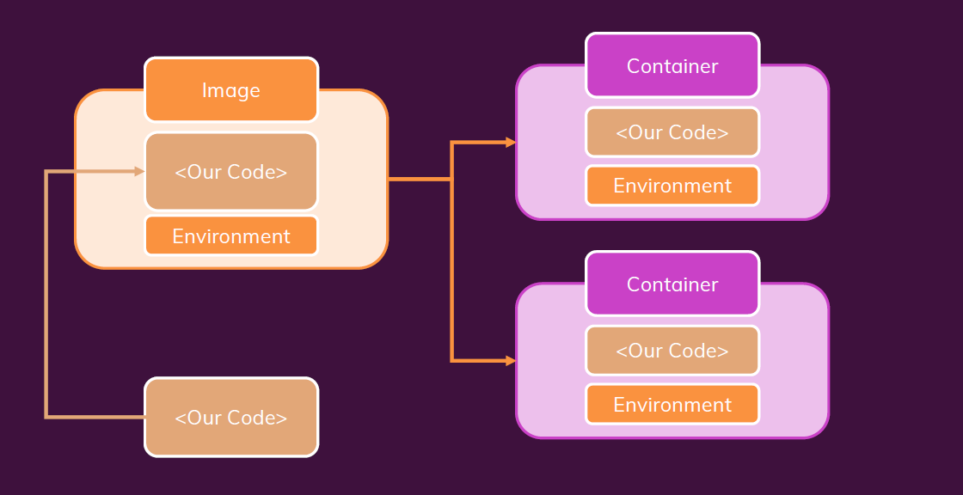
First Summary

Slide 18
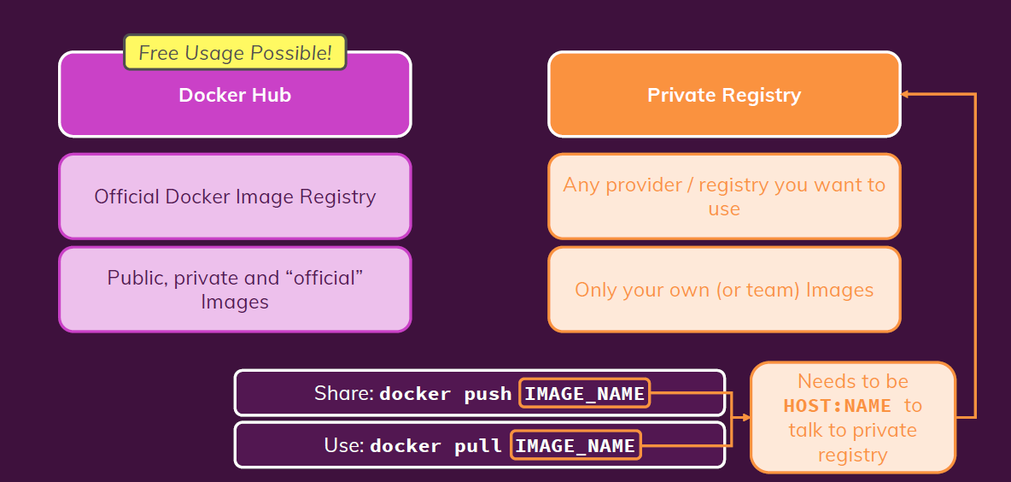
Registries
It’s repository that used to push images to it and
pull them to use that images again in another projects.
Popular registries :
Azure Container Registry.
Amazon Elastic Container Registry (ECR).

